Slide 1
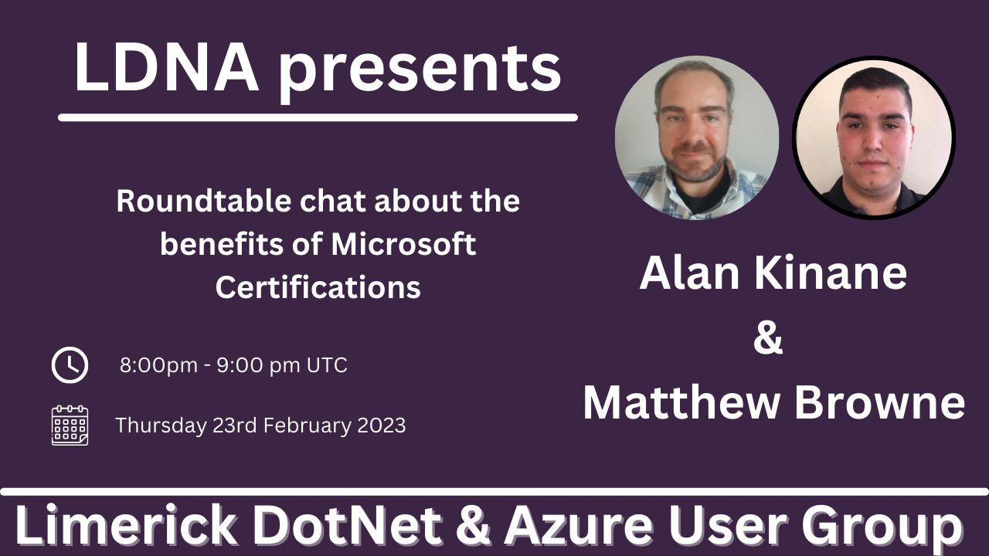

Slide 2
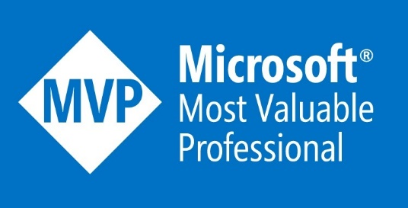
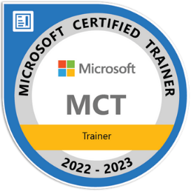





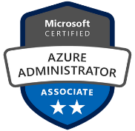


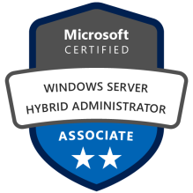

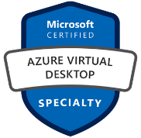
Alan Kinane (Azure MVP)
Bio: Alan has been an IT Professional for over 20 years. Specialising in infrastructure, he has a strong focus on cloud services and in particular with Microsoft Azure which he has been using since 2015. Alan works for MicroWarehouse, an Irish cloud aggregator as Azure technical lead. This varied role involves assisting Microsoft partners with pre-sales consultations, solution architecture and delivering sales and technical training.
Alan is a Microsoft Azure MVP and a Microsoft Certified Trainer. He likes to write blogs on Microsoft Azure and participate in community events.
https://azurealan.ie
@azure_alan
http://www.youtube.com/@azure_alan

Slide 3




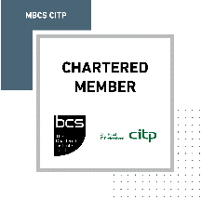
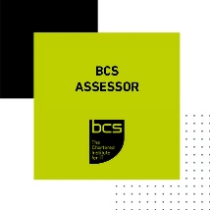

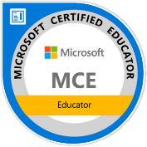





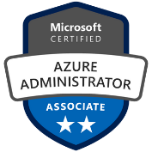


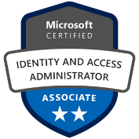
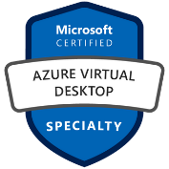


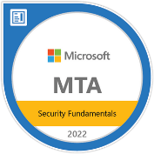

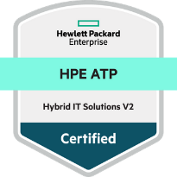

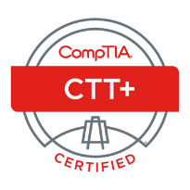



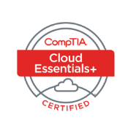

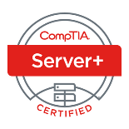





Matthew Browne
(Microsoft Azure & Security MVP) & (CompTIA SME)
Technology Evangelist
Bio: Matthew has been an IT Professional over the last 15 years. Specialising in Core infrastructure , Cybersecurity and Azure. Matthew has worked with SMB’S and Enterprise Clients across Ireland to deliver Microsoft solutions to companies in Ireland. Matthew’s role has involved designing implementing and supporting IT Solutions across multiple vendors. Alongside Matthew’s Day time career Matthew is a Microsoft Azure & Security MVP , MCT , MCE.
At night Matthew is a Microsoft Certified Trainer and Educator to students throughout the world Teaching students the Microsoft Curriculum and teaching night courses at multiple colleges alongside working with the team at Journey To The Cloud where he presents on different topics this is the online community which Matthew Founded back in 2020.
https://www.focus-it.ie
https://www.credly.com/users/matthew-browne.59a46200/badges
@AzureGuruMatt
http://www.youtube.com/c/AzureGuruMatt

Slide 4
Agenda
Microsoft Exams – categories and levels
Certification value to individuals
Certification value to Microsoft partners
Format of exams and exam scheduling options
Exam renewal process
Exam preparation
Matthew and Alan's top tips for exam preparation
Q & A

Slide 5
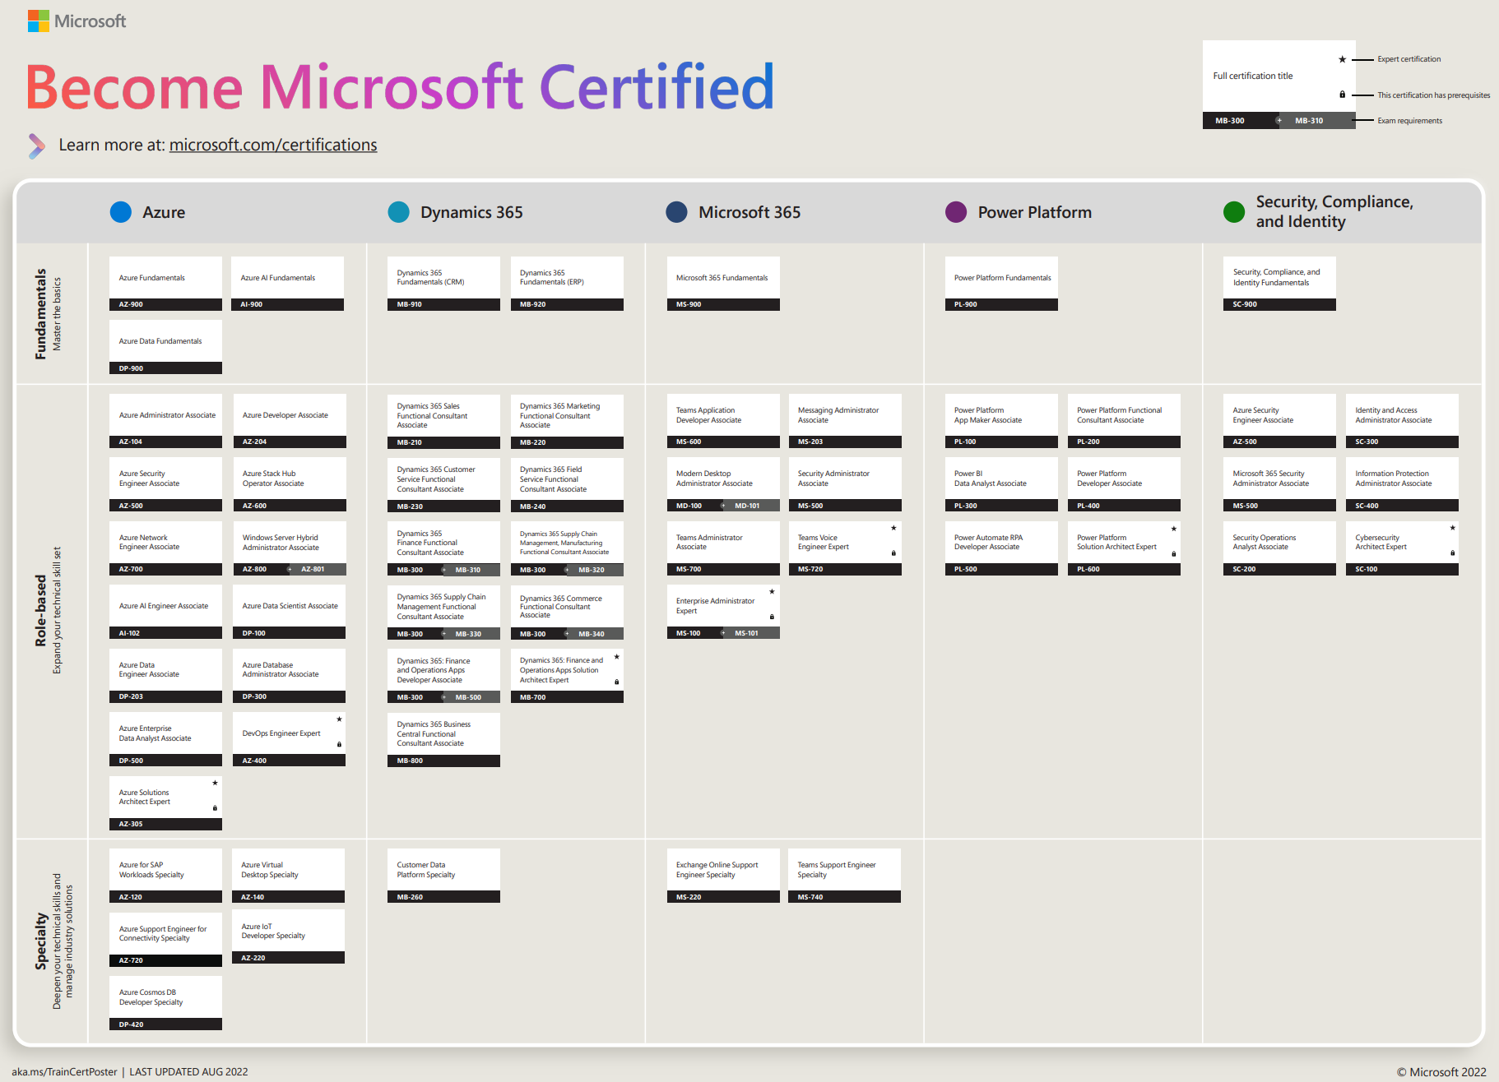

Slide 6
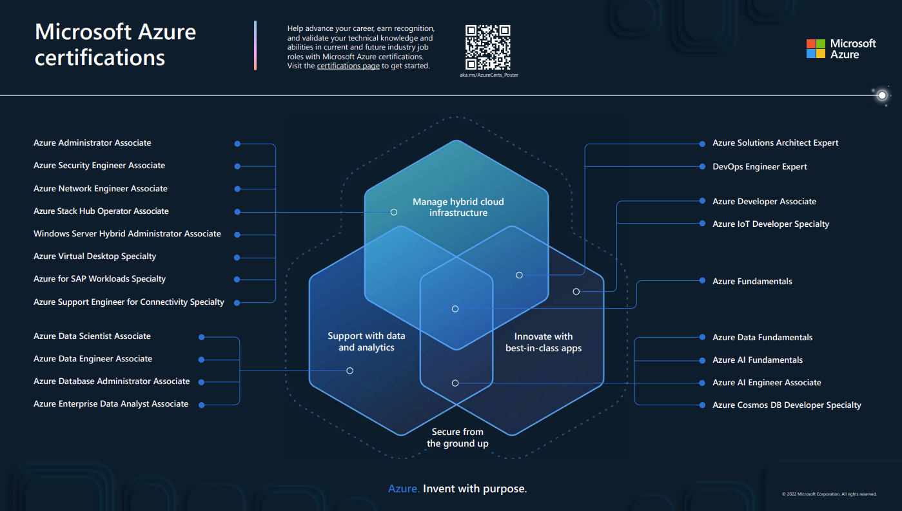

Slide 7
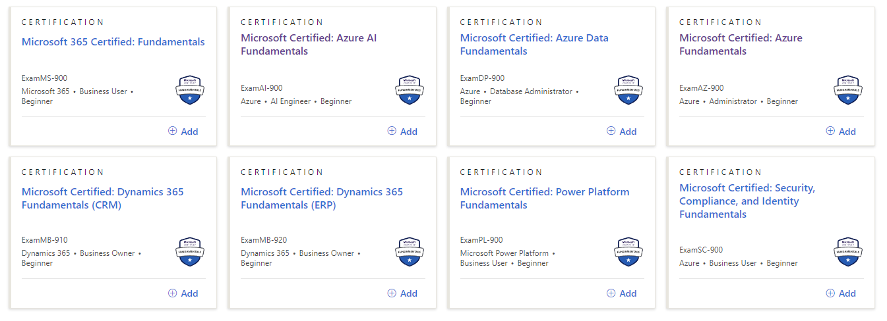
The Value of Fundamentals
Gaining the confidence to advance to bigger projects and better roles at your organization
Build a foundation for in-demand jobs by learning industry-standard technology
Strive to learn the vocabulary, features, and basics of a chosen technology

Slide 8
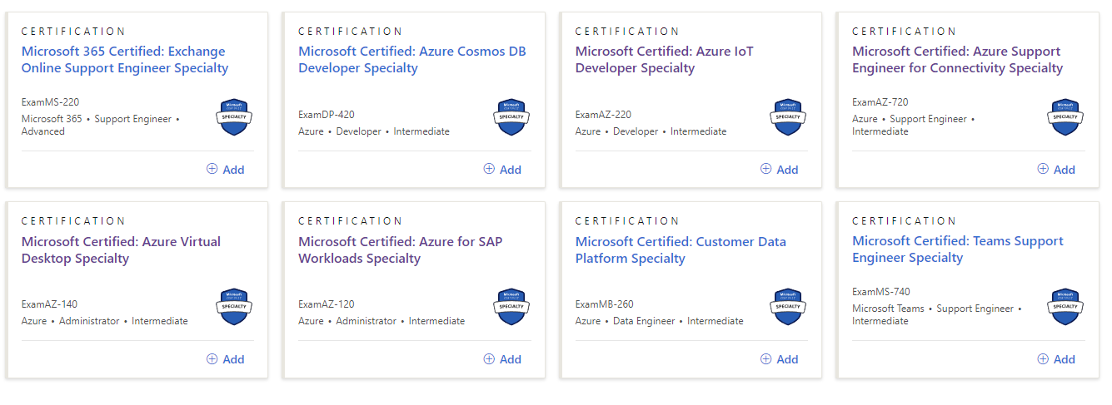
The Value of Specialty
Shows Subject Matter Expertise in a chosen Area

Slide 9
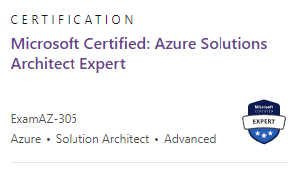
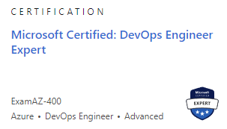
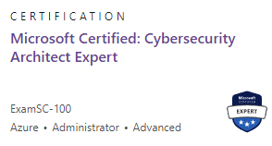
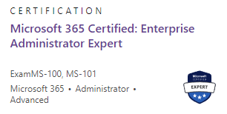
Why Expert Level Certification ?
SME Status - Demonstrate Subject Matter Expertise in a Chosen Technology by obtaining popular certification.
Career Advancement - Advanced your career to higher level positions.
Salary – Undertake certification to earn a higher salary.
Azure Training + Certification Guide (microsoft.com)

Slide 10
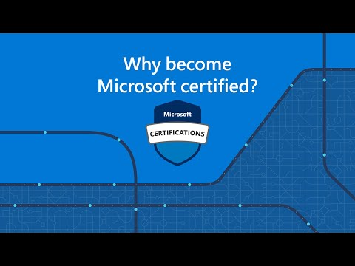
Why get Microsoft Certified As an IT Professional

Slide 11

Why get Microsoft Certified as a Student

Slide 12
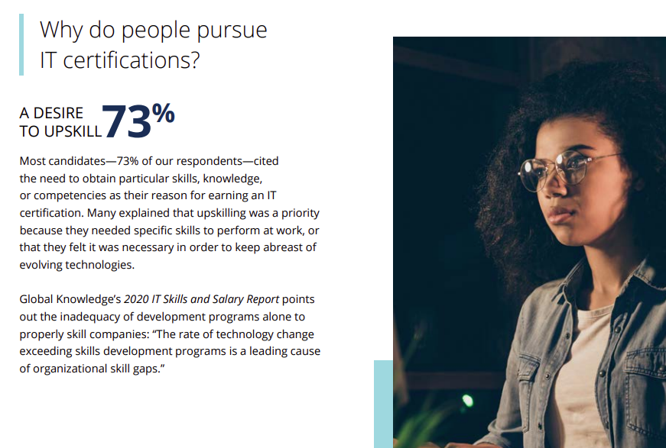
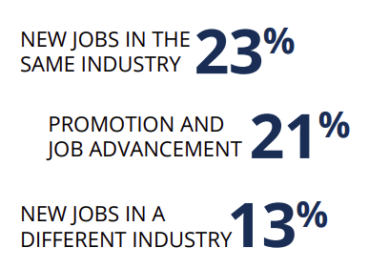
Why undertake Certification ?
New Job
Promotion
Salary
Career Change
New Skill

Slide 13

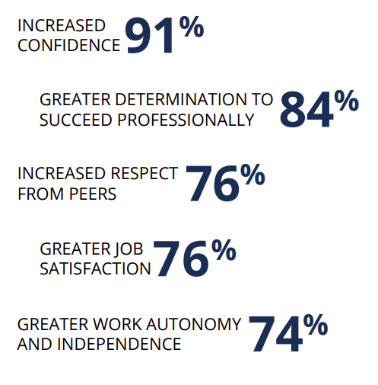
Personal Benefits

Slide 14
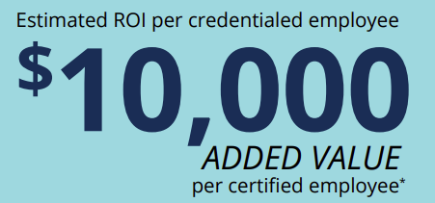
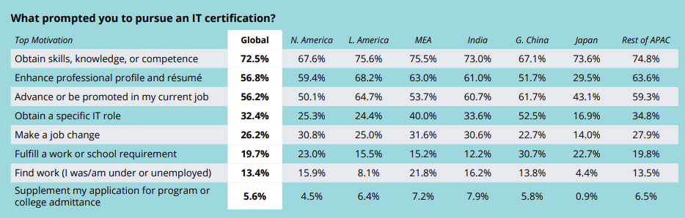
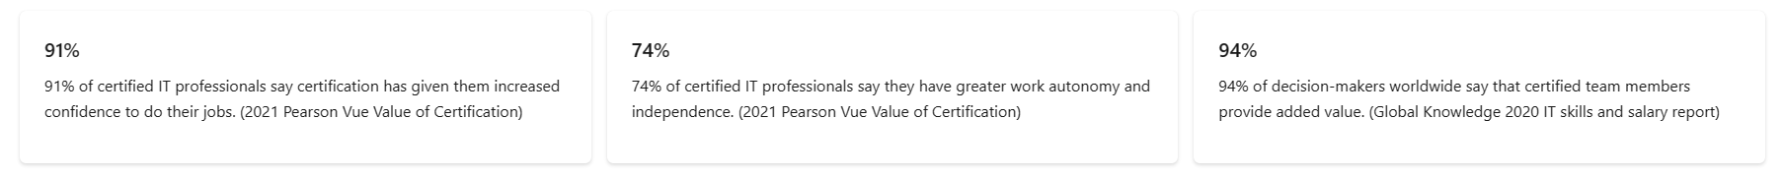
Overall Metrics Behind Up-Skilling

Slide 15
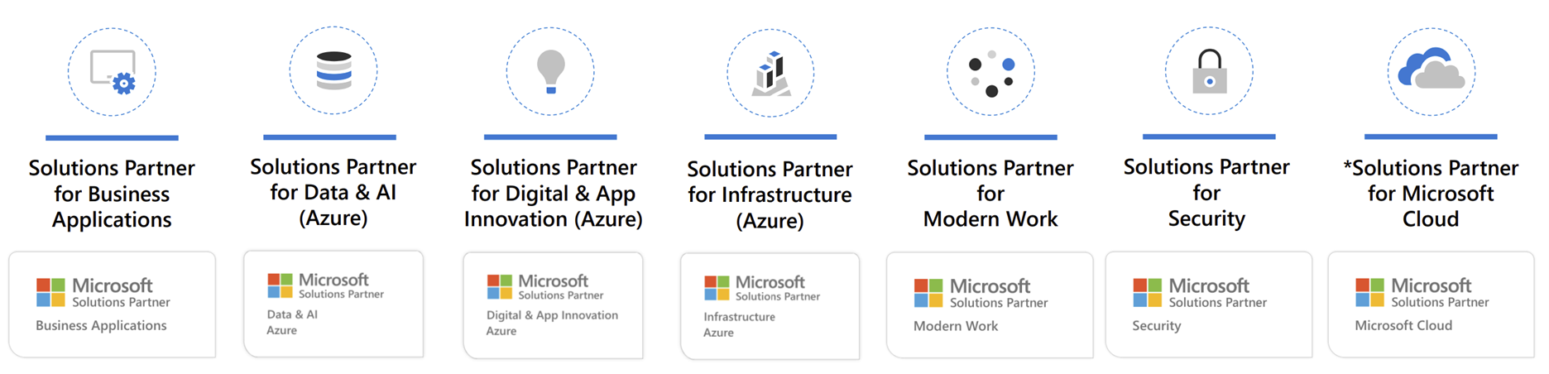
What is the Microsoft Cloud Partner Program?
Main Benefits:
Internal use subscriptions
Bulk Azure credits for internal use
Earn rebates on your customer sales
Recognition

Slide 16
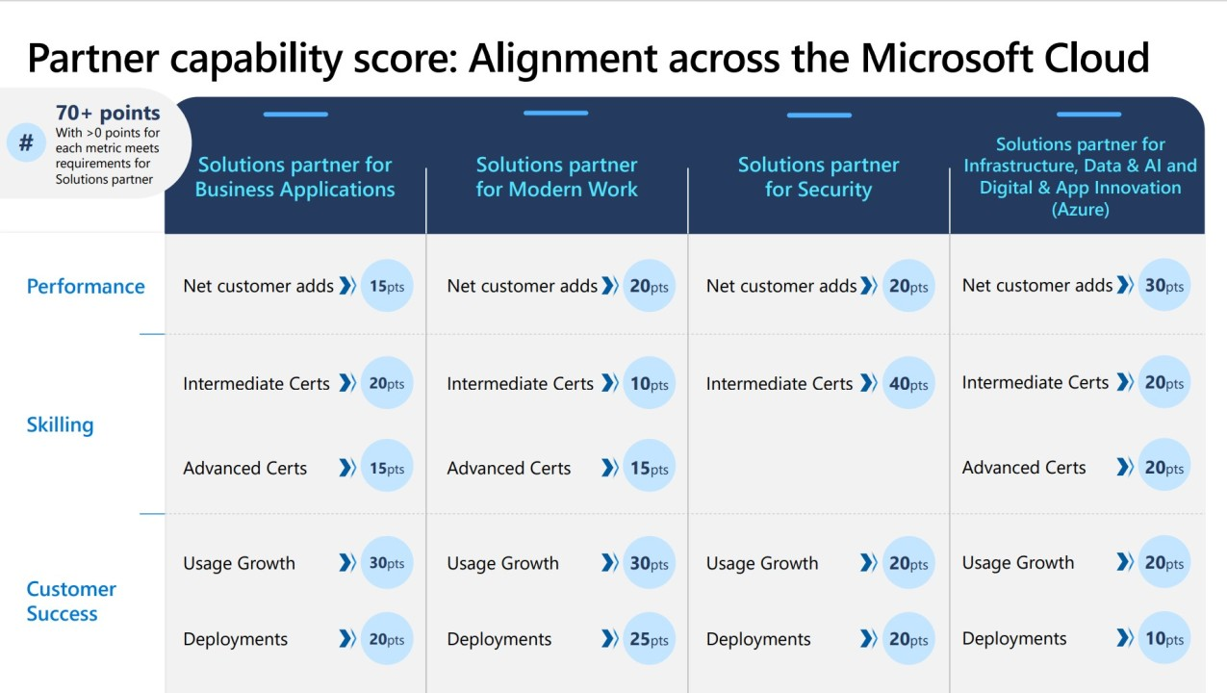
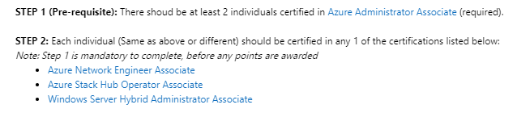
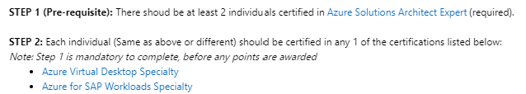
Skilling requirement for Solutions Partner for Infrastructure (Azure)

Slide 17

Exam Format
Exam Duration:
45 Minutes (Fundamentals)
Up to 120 minutes (Associate/Expert)
Usually between 40-60 questions
Question Format:
Multiple Choice
Drag and drop / build lists
Case Studies
Hands-on Labs
Answers can be reviewed within the same section only
Passing score is 700 points out of a maximum 1,000

Slide 18
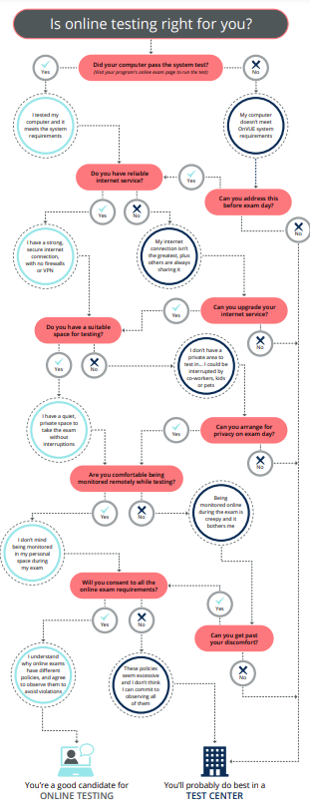

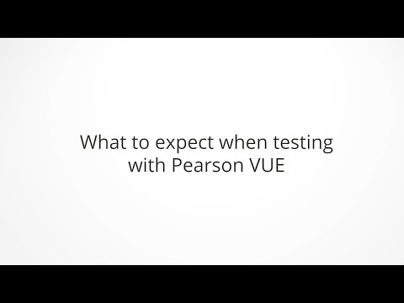
Testing Options IN- Person & Online

Slide 19
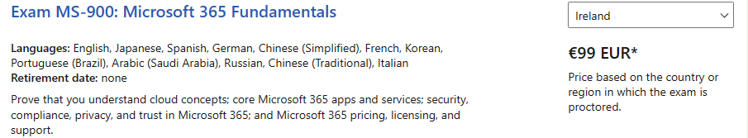
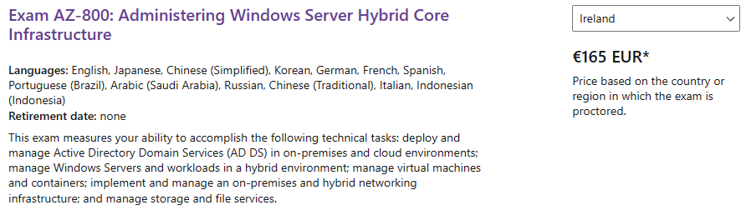
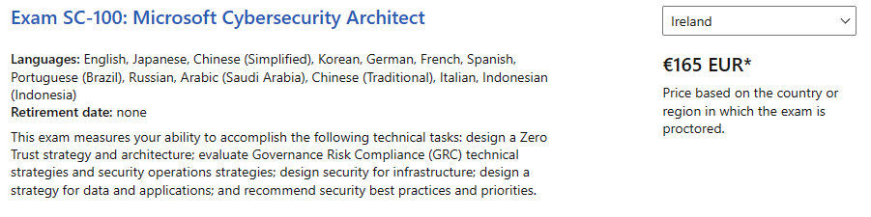
Certification Costs
Fundamental Level
Associate Level
Expert Level

Slide 20
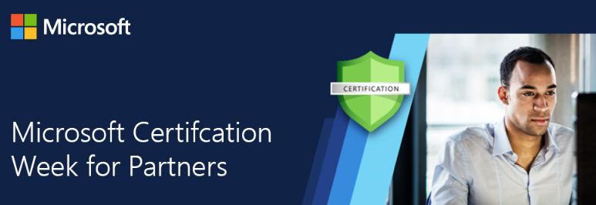
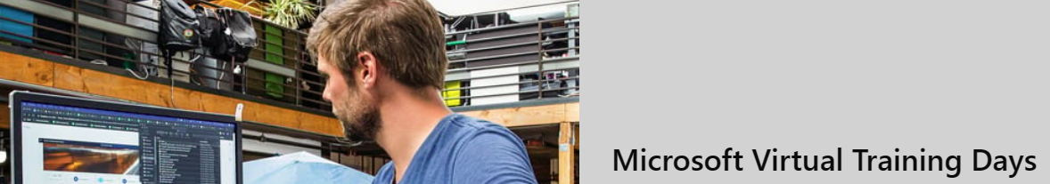

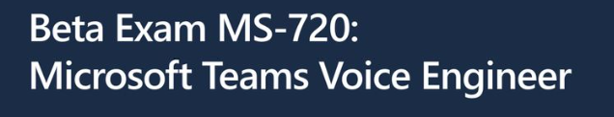
Ways of Getting Discounts
Cloud Skills Challenges
Beta Exams
Microsoft Training Day
Partner Discounts

Slide 21
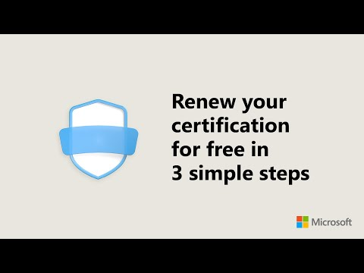
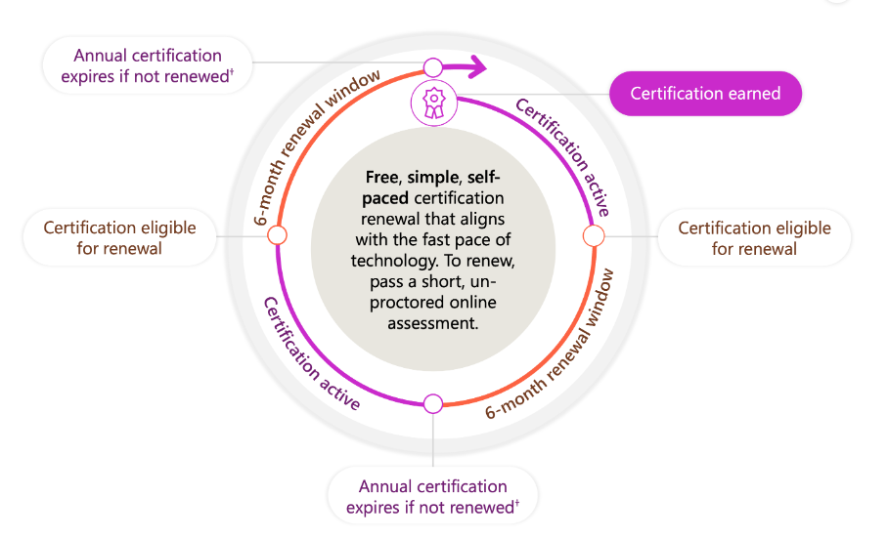
Microsoft Renewals

Slide 22

Exam Preparation Resources
Microsoft Learn
Microsoft Learn exam practice assessment (Free but available on very few exams currently)
MeasureUp "Official Microsoft" practice tests (Fee based)
Third party online training courses and practice tests (Fee based)
Microsoft Azure trial account

Slide 23
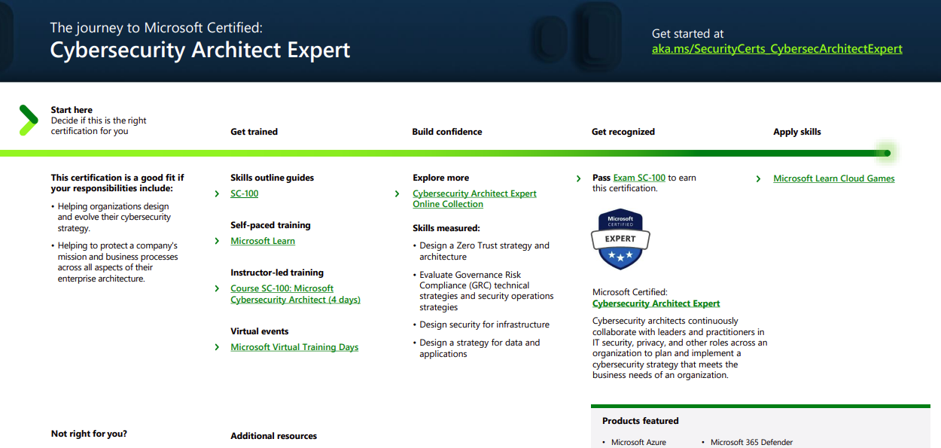

Pathway to Certification
Microsoft Provide Certification Guides and Paths To individuals looking to get certified.
Azure Training + Certification Guide (microsoft.com)

Slide 24
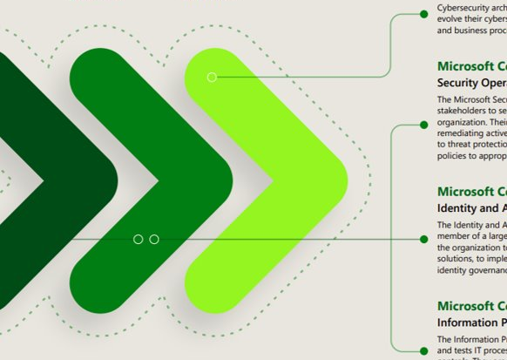
Matthews Top 3 Tips: Master the Basics Industry Experience Grow Your Knowledge

Slide 25
Alan's Top 3 Tips: Learn by doing Focus on your weaknesses Set exam date early and stick to it!

Slide 26

Click here to register:
https://www.eventbrite.ie/e/securing-azure-infrastructure-tickets-545386464597

Slide 27

Q & A

